Slide 1
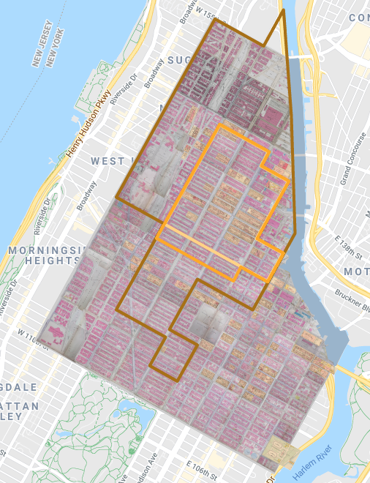
Sample Digital Humanities Mapping Projects
Digital Harlem, http://digitalharlem.org/

Slide 2
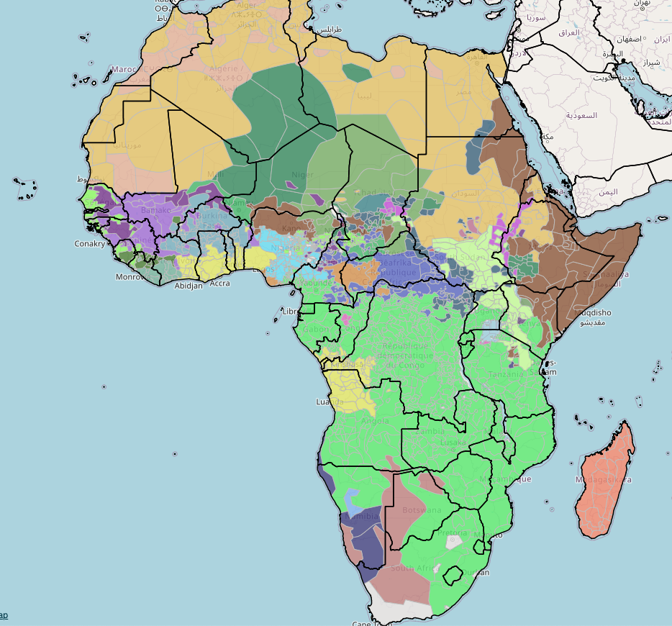
Africamap
https://worldmap.harvard.edu/africamap

Slide 3
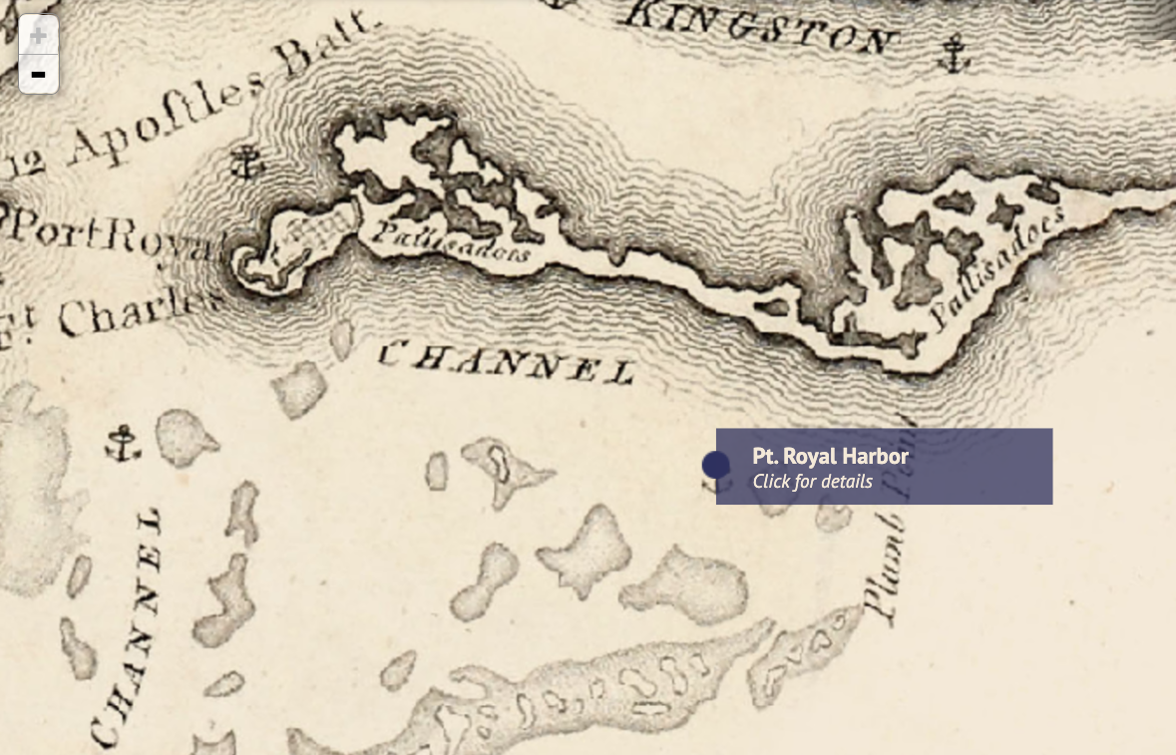
Slave Revolt in Jamaica, 1760-1761
http://revolt.axismaps.com/

